Slide 1
Aviation English
Axumawit Gebregorgis
Oleksandr Gorkovets
Ramona Graham

Slide 2
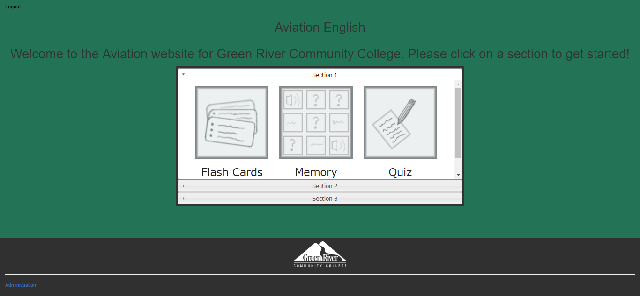
Main Page of the previous version

Slide 3
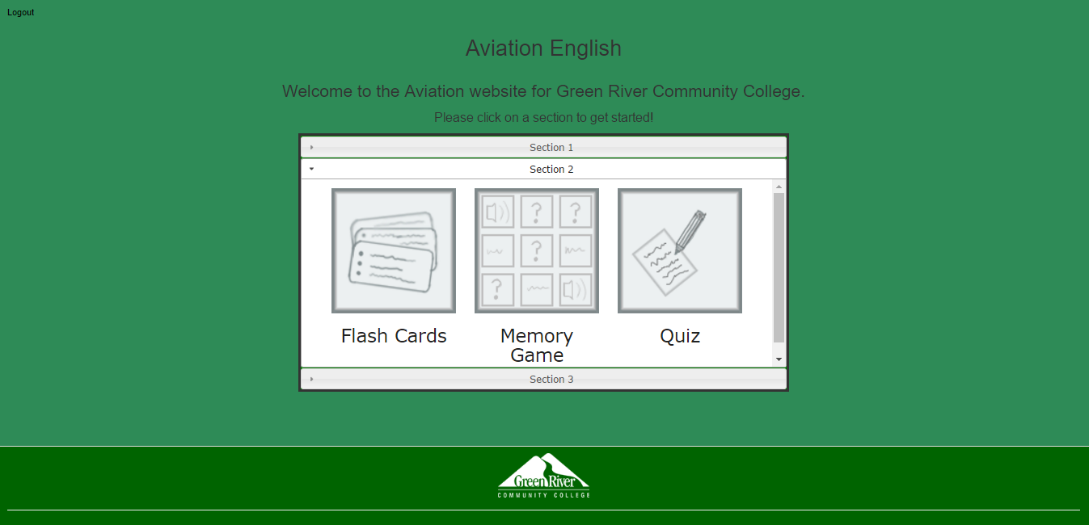
The new main page

Slide 4
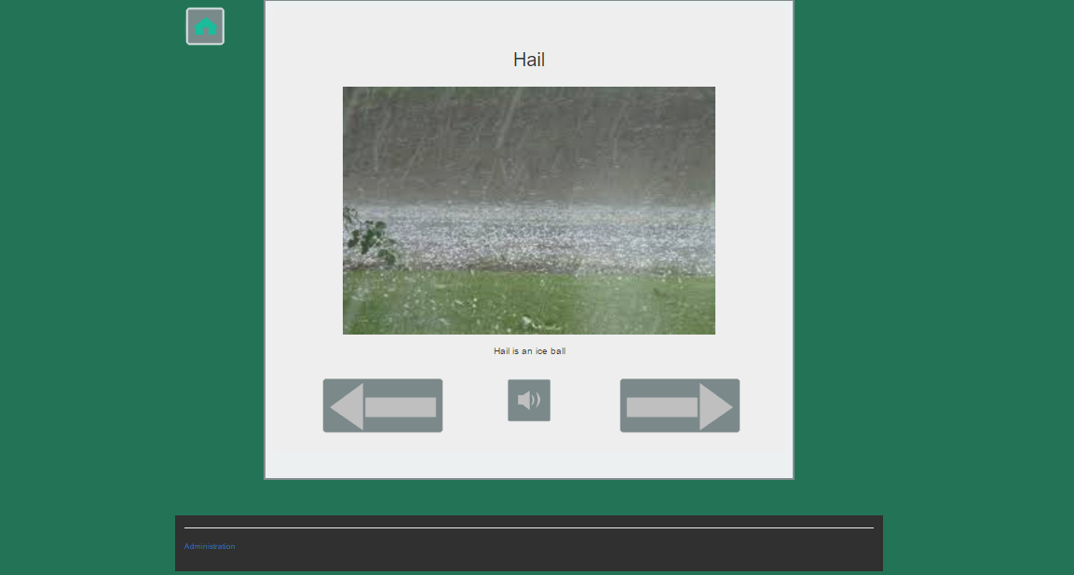
The Flash Cards page of the previous version

Slide 5
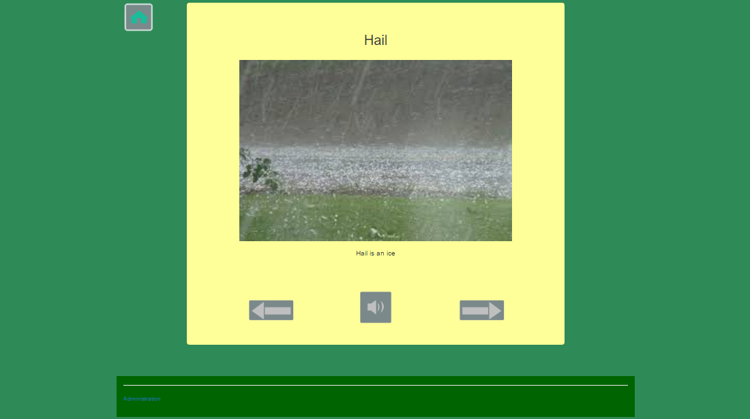
The new Flash Cards page

Slide 6
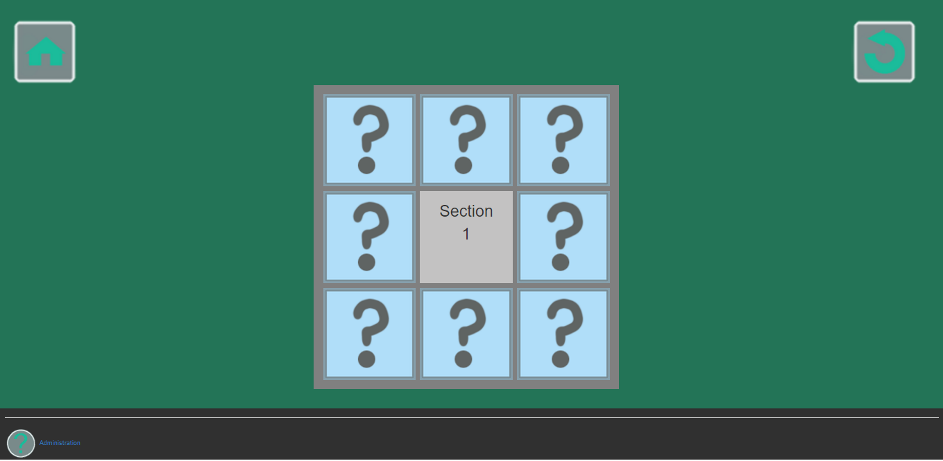
The previous Memory Game page

Slide 7
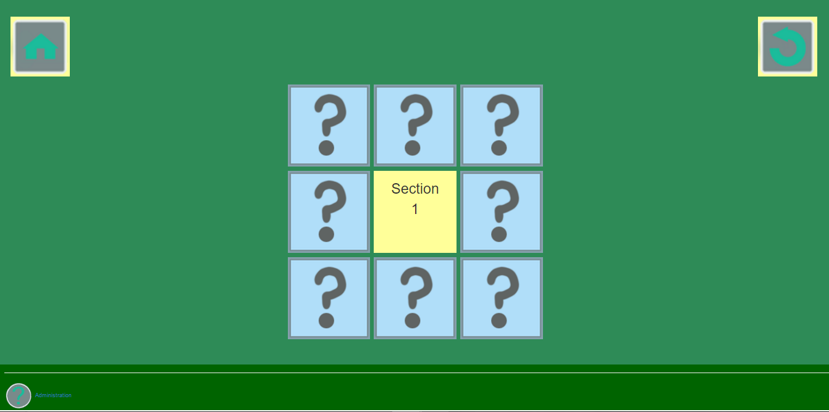
The new Memory Game page

Slide 8
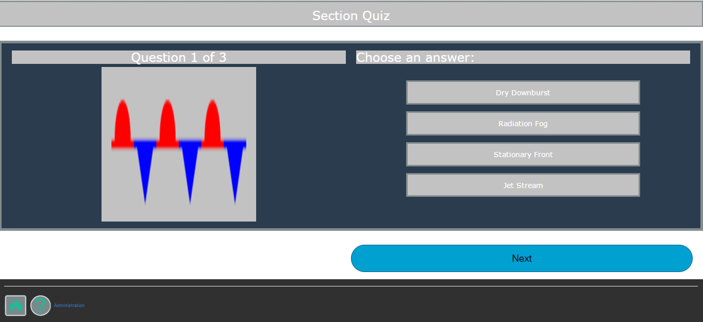
The previous Quiz page

Slide 9
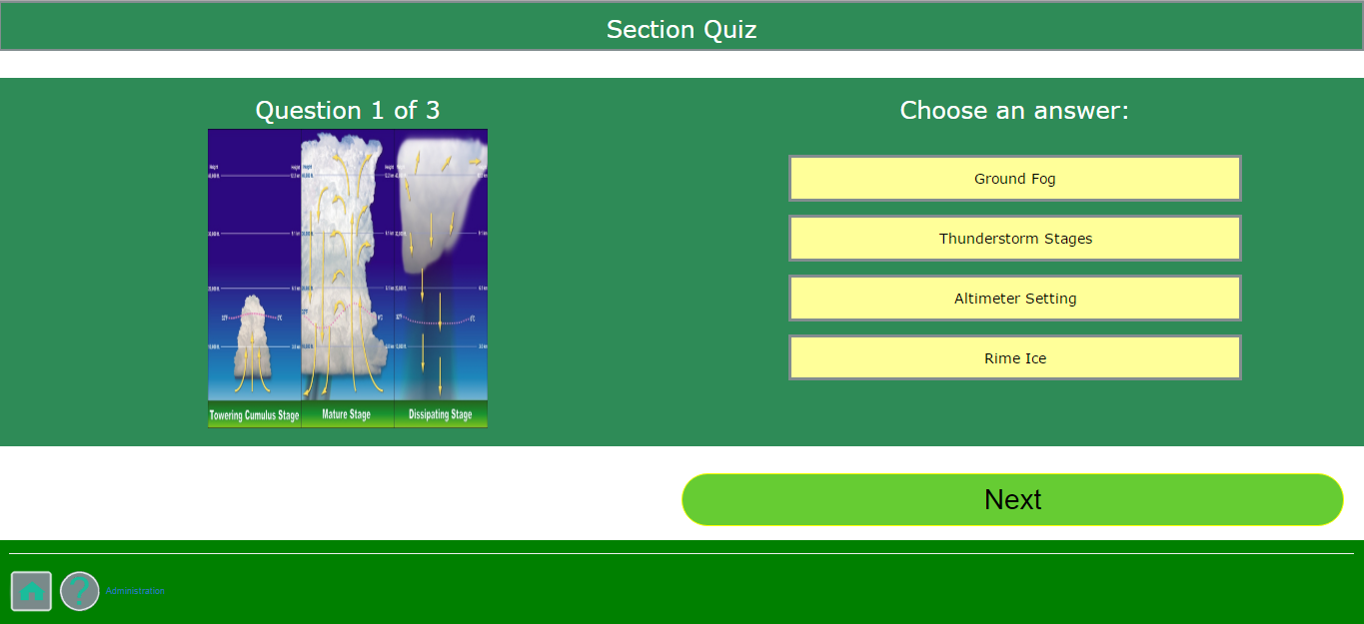
The new Quiz page

Slide 10
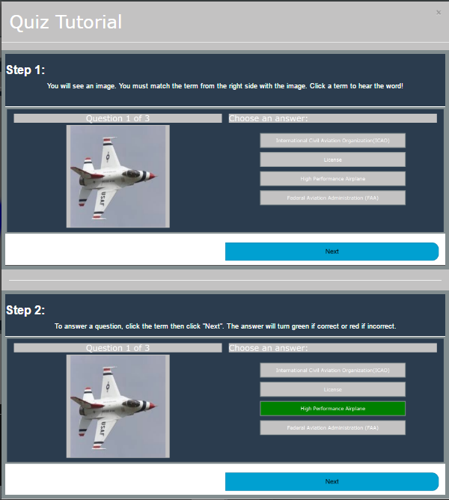
The previous Quiz Tutorial Page

Slide 11
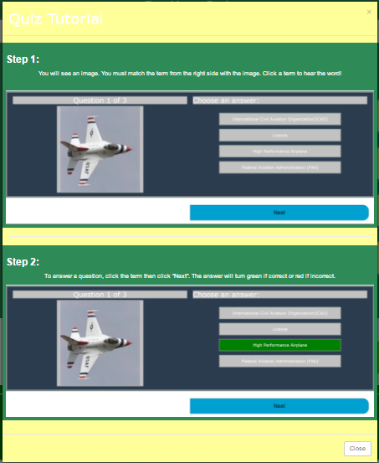
The new Quiz Tutorial page

Slide 12
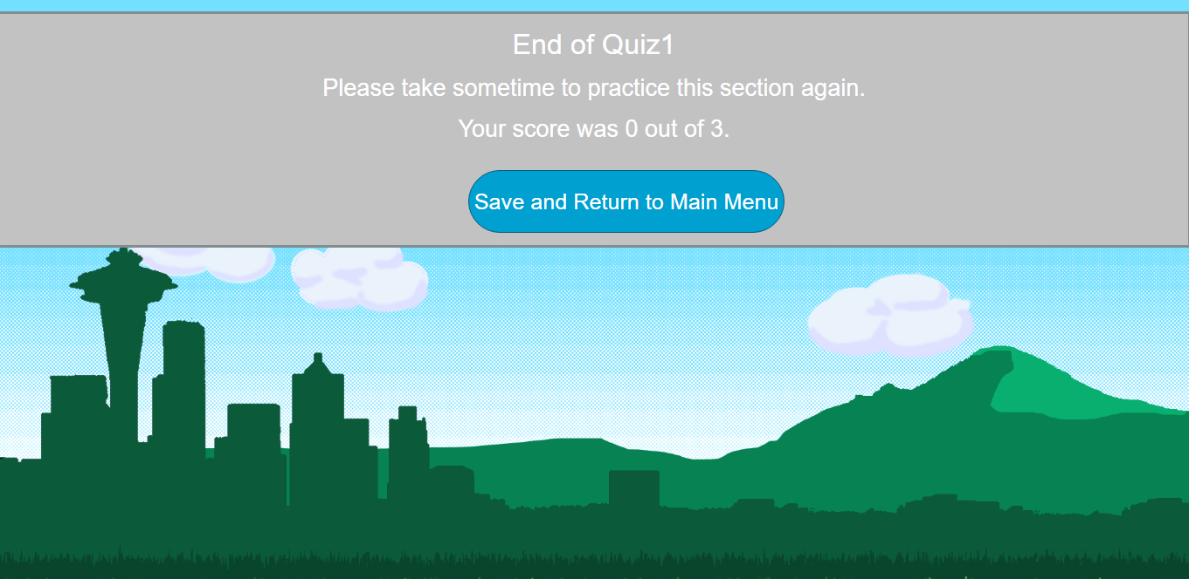
The previous End of Quiz page

Slide 13
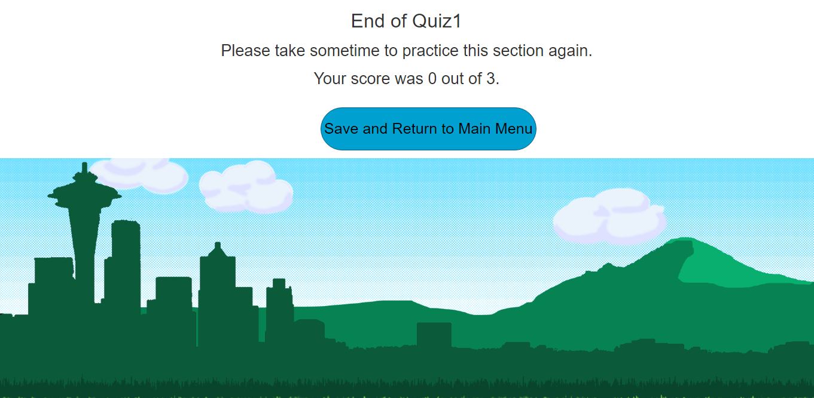
The new End of Quiz page

Slide 14
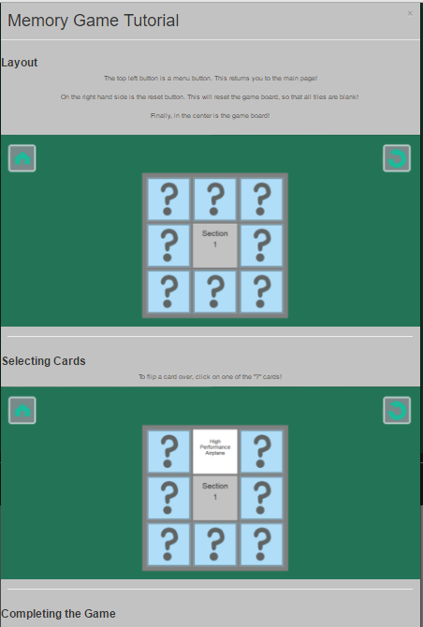
The previous Memory Game Tutorial page

Slide 15
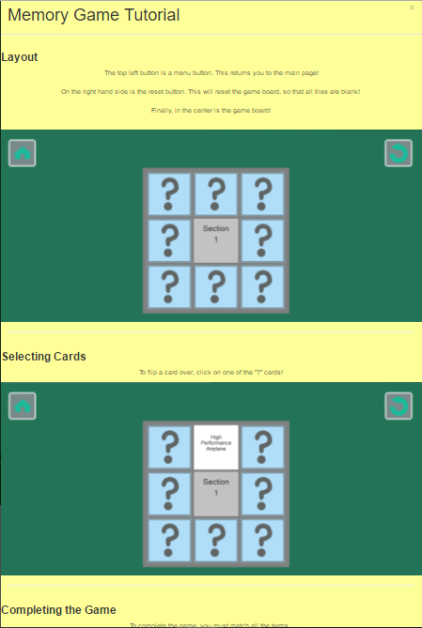
The new Memory Game Tutorial page

Slide 16
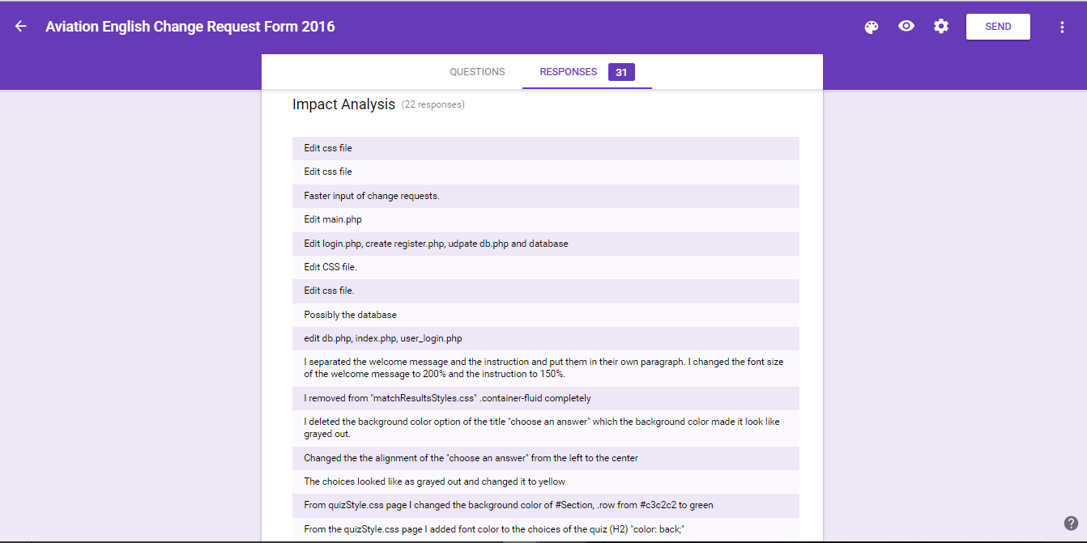

Slide 17



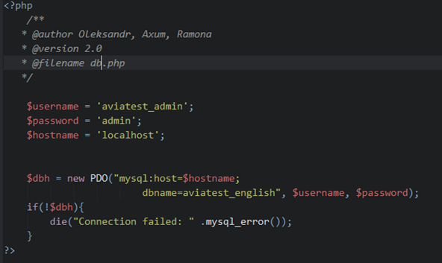


Code Reuse
db.php
main.php
main.php
main.php

Slide 18
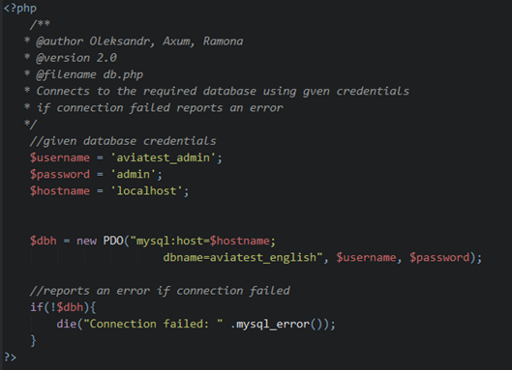
Comments
Use comments in the code to help to maintain the code

Slide 19
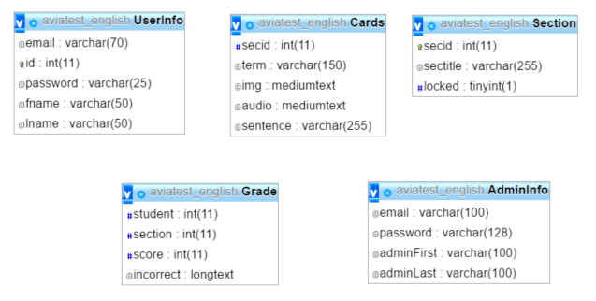
Database aviatest_english

Slide 20
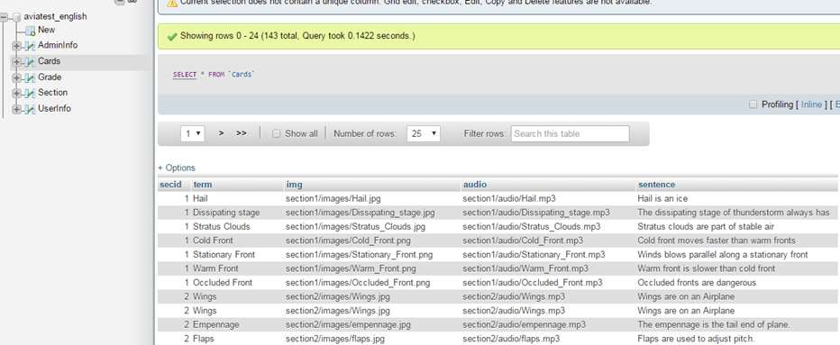
Database

Slide 21
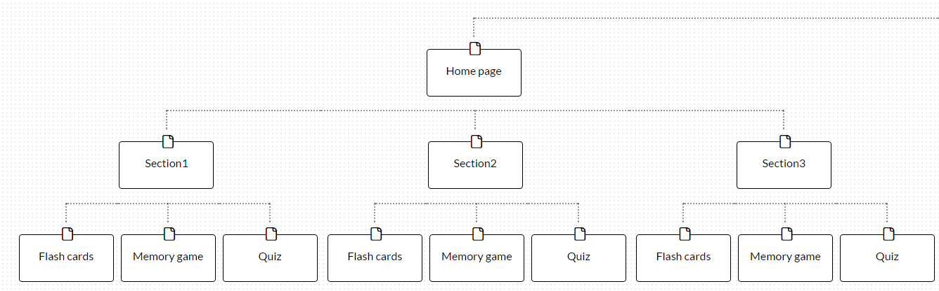
File Structure

Slide 22
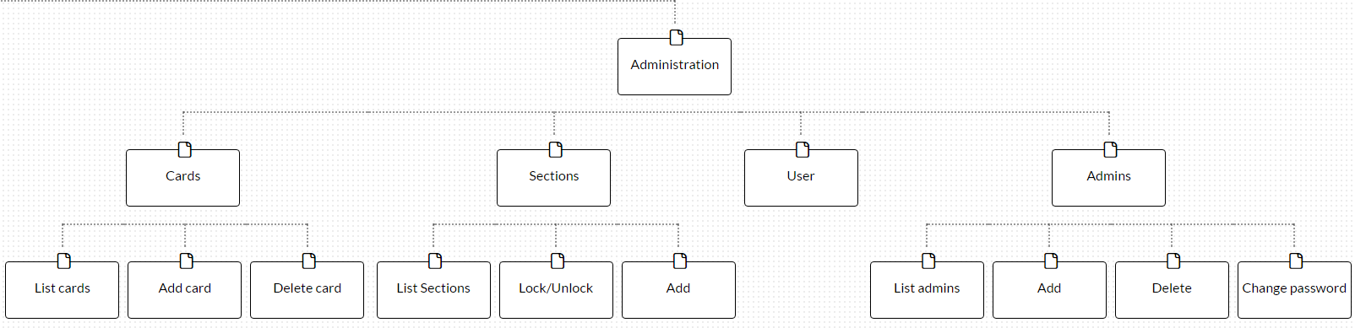

Slide 23
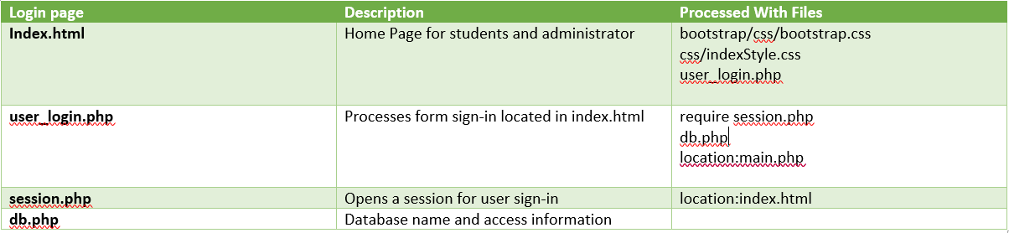
File structure cont.

Slide 24
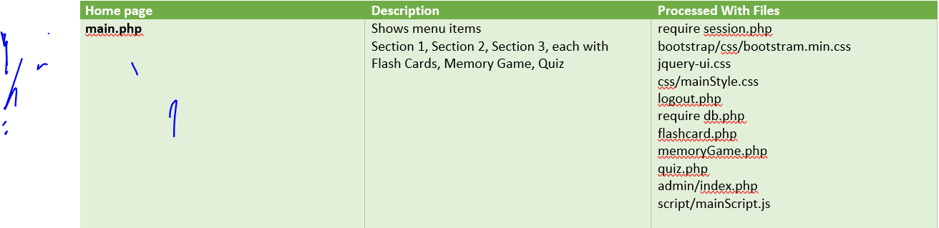
File structure cont.

Slide 25
Lessons Learned
* We have to be careful when we make changes. One minor change could crash the whole project.
* Provide comments for each line of code, because it will minimize the time spent to comprehend the project for the next team who will took over for maintenance
* Review the Working Agreement and revise if necessary
* Had to learn to work with different work styles
* Had to make sure we communicated changes so that we did not overwrite each other’s changes
* The best practice is code reuse to eliminate repeating same lines of code in different files

Slide 26
Challenges
* Originally started off with the wrong code, had to wait to get the code that mirrored the live site
* Had to re-enter the whole database
* Finding time for the whole team to meet
* Sharing understanding of all parts of the project so that effort is not duplicated
* Learning about the project code, and database
* There were so many CSS files and since there was not any description, it was not easy to find which CCS page do the styling for a particular page
* We had no user responses on the site so it was hard to make right decision what have to be changed

